Slide 1
Machine Unlearning Survey

Slide 2
Overview
1. MU
2. Review
SalUn
Learning to unlearn
UNSC
SSD

Slide 3
1. Machine Unlearning
target
Unlearn data에 대해 모델을 어떻게 조정해야 효율적일지

Slide 4


2-1 SalUn
Saliency Unlearning (ICLR 2024)
Weight saliency map by gradient of forgetting loss
Unlearning model parameter
(관련 있으면 1, 관련 없으면 0)
(0이면 original)

Slide 5
2-1 SalUn
Classification, Generation adaptive
Model-agnostic

Slide 6
2-2 Learning to Unlearn
Learning to Unlearn: Instance-wise Unlearning for Pre-trained Classifiers (AAAI 2024)
Instance-wise unlearning by Misclassification
Adversarial examples, Weight importance measures
Remaining 데이터의 forgetting은 줄이고 제거 데이터는 Misclassifying
Model-agnostic, continual unlearning

Slide 7
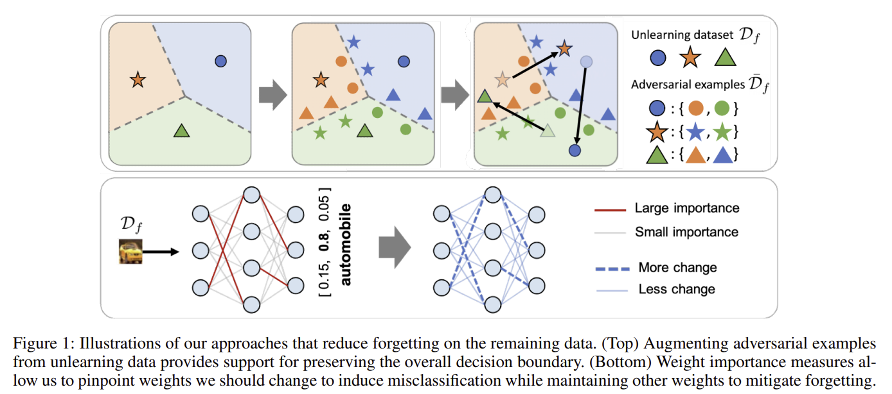


2-2 Learning to Unlearn
(adversarial example 생성식)
(weight importance meseaure)

Slide 8
2-3 UNSC
Unlearning via Null Space Calibration (IJCAI 2024)
Null space unlearning
Pseudo-labeling
위 두 방식을 활용하여 Over unlearning 방지

Slide 9






2-3 UNSC
1. Null space unlearning
1-1. Null space definition
1-3. Subspace
1-2. SVD(특이값 분해)
1-4. Subspace for other classes
(R = 클래스 k, l번째 레이어, 피쳐)

Slide 10



2-3 UNSC
2. Pseudo labeling
1-5. projection matrix
제일 유사한 class로 labeling
1-6. weight

Slide 11
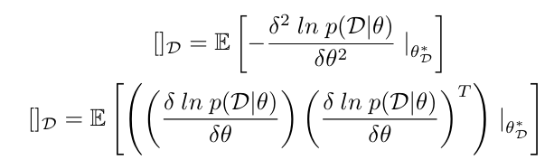
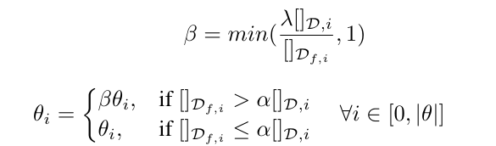
2-4 SSD
Selective Synaptic Dampening (AAAI, 2024)
Hessian and the Fisher information matrix
Selective Synaptic Dampening
위 두 방식을 활용하여 unlearning

Slide 12
entanglement-reduced mask (ERM) - knowledge transfer and prohibition (KTP)
Separate the Wheat from the Chaff: Model Deficiency Unlearning via Parameter-Efficient Module Operation = LLM
Towards Effective and General Graph Unlearning via Mutual Evolution = GNN
ERASER: Machine Unlearning in MLaaS via an Inference Serving-Aware Approach = MLaaS
Brainwash: A Poisoning Attack to Forget in Continual Learning = poisoning CL
Tangent Transformers for Composition,Privacy and Removal = transfoermer선형화
Learn To Unlearn for Deep Neural Networks: Minimizing Unlearning Interference With Gradient Projection = SVD
UnlearnCanvas: A Stylized Image Dataset to Benchmark Machine Unlearning for Diffusion Models = unlearn dataset in diffusion
A Unified and General Framework for Continual Learning = fisher map in CL
Label-Agnostic Forgetting: A Supervision-Free Unlearning in Deep Models = unsupervised condition

